Slide 1
Projection of planes UNIT- III

Slide 2
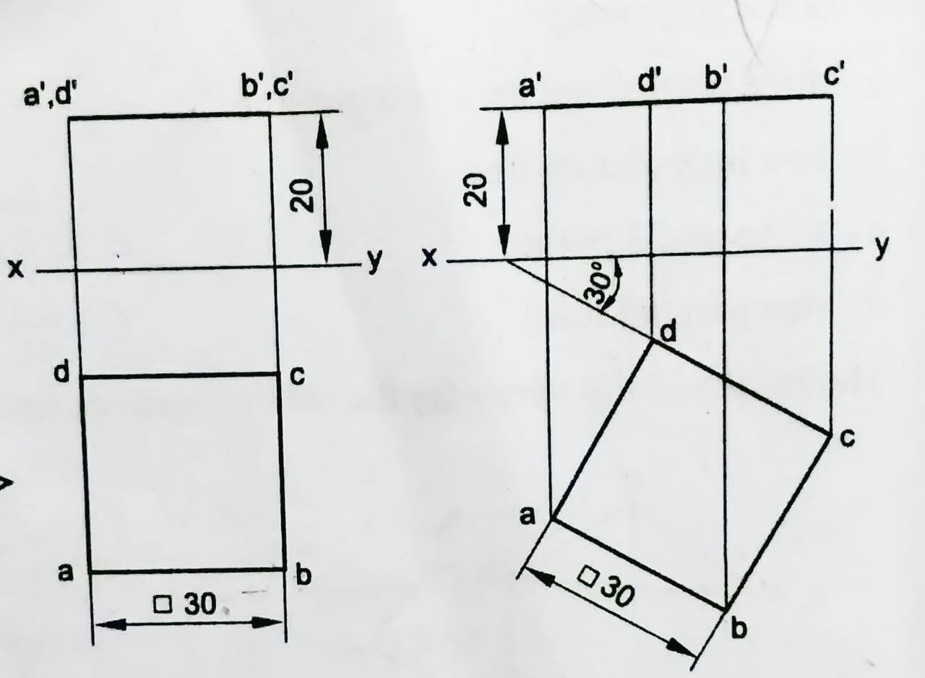
31. A square plane ABCD of side 30, is parallel to H.P and 20 away from it. Draw the projections of the plane, when two of its sides are (i) parallel to V.P and (ii) inclined at 30° to V.P.

Slide 3
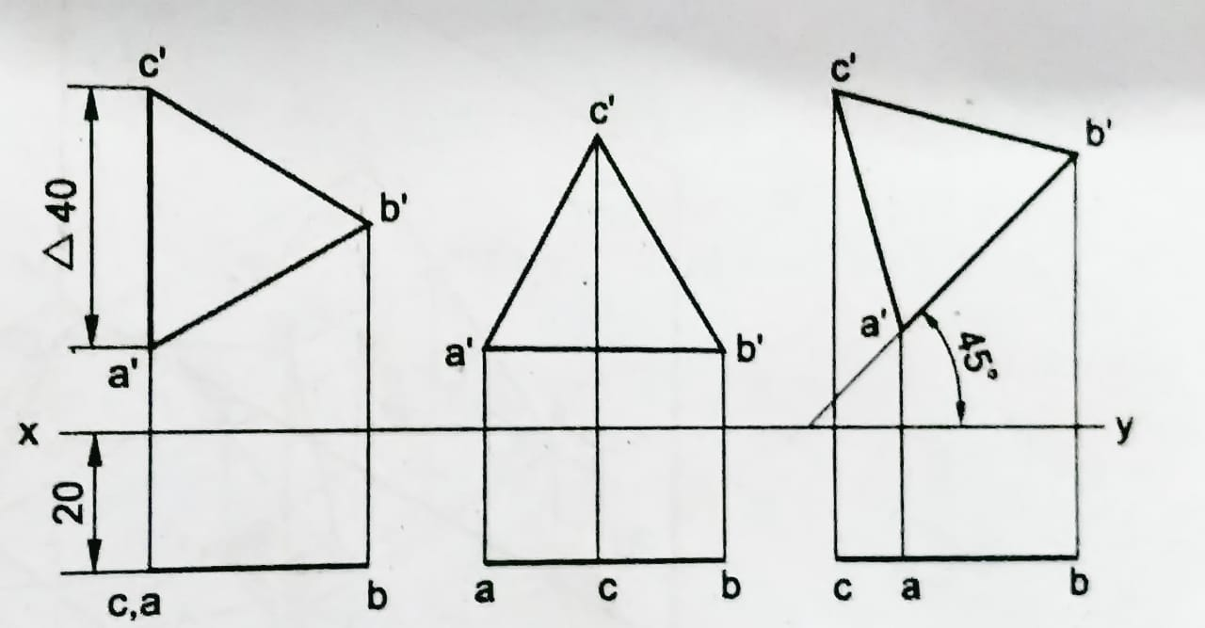
32. An equilateral triangular plane ABC of side 40, has its plane parallel to V.P and 20 away from it. Draw the projections of the plane when one of its sides is (i) perpendicular to H.P. (ii) parallel to H.P and (iii) inclined to H.P ut an angle of 45°.

Slide 4
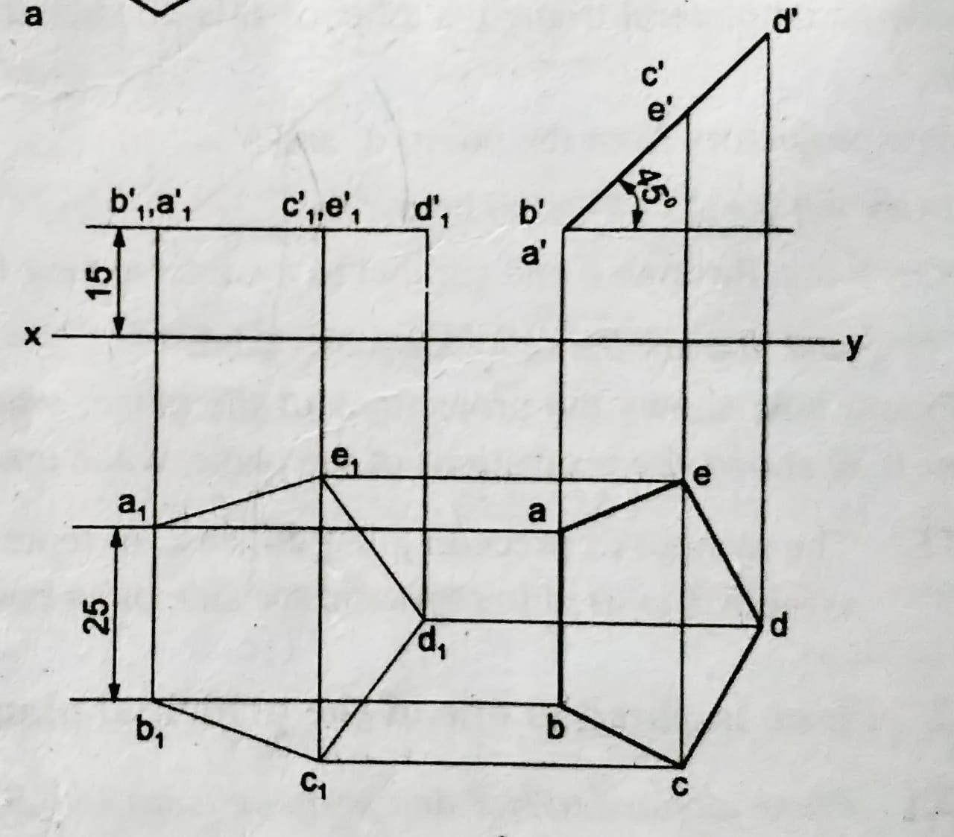
33. Draw the projections of a regular pentagon of 25 side with its surface making an angle of 45° with H.P. One of the sides of the pentagon is parallel to H.P and 15 away from it.

Slide 5
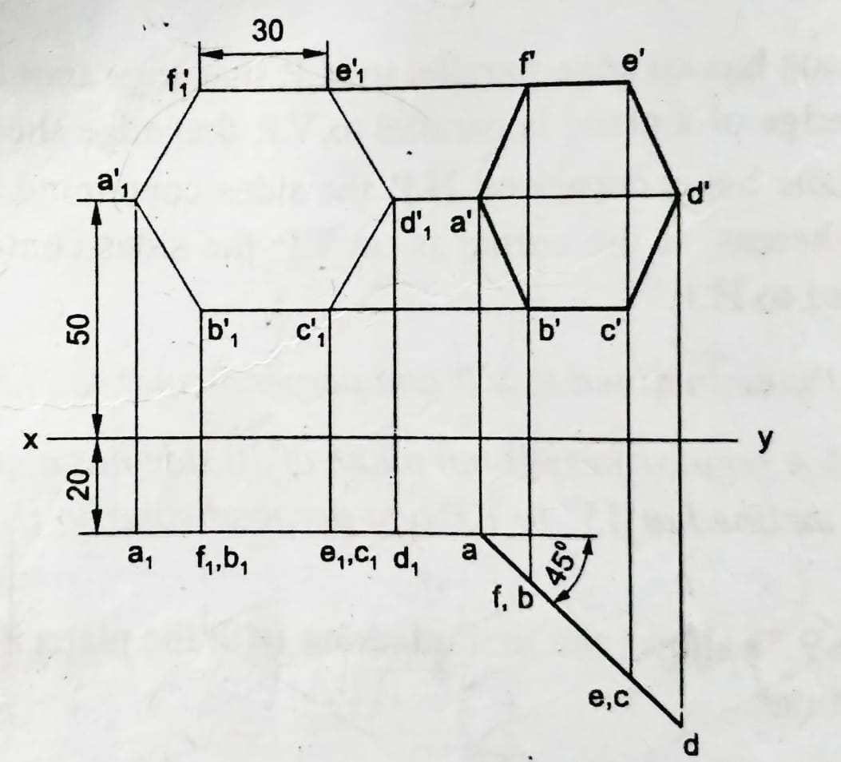
34. A regular hexagonal plane of 30 side has a corner at 20 from VP and 50 from H.P. Its surface is inclined at 45° to VP and perpendicular to H.P. Draw the projections of the plane.

Slide 6
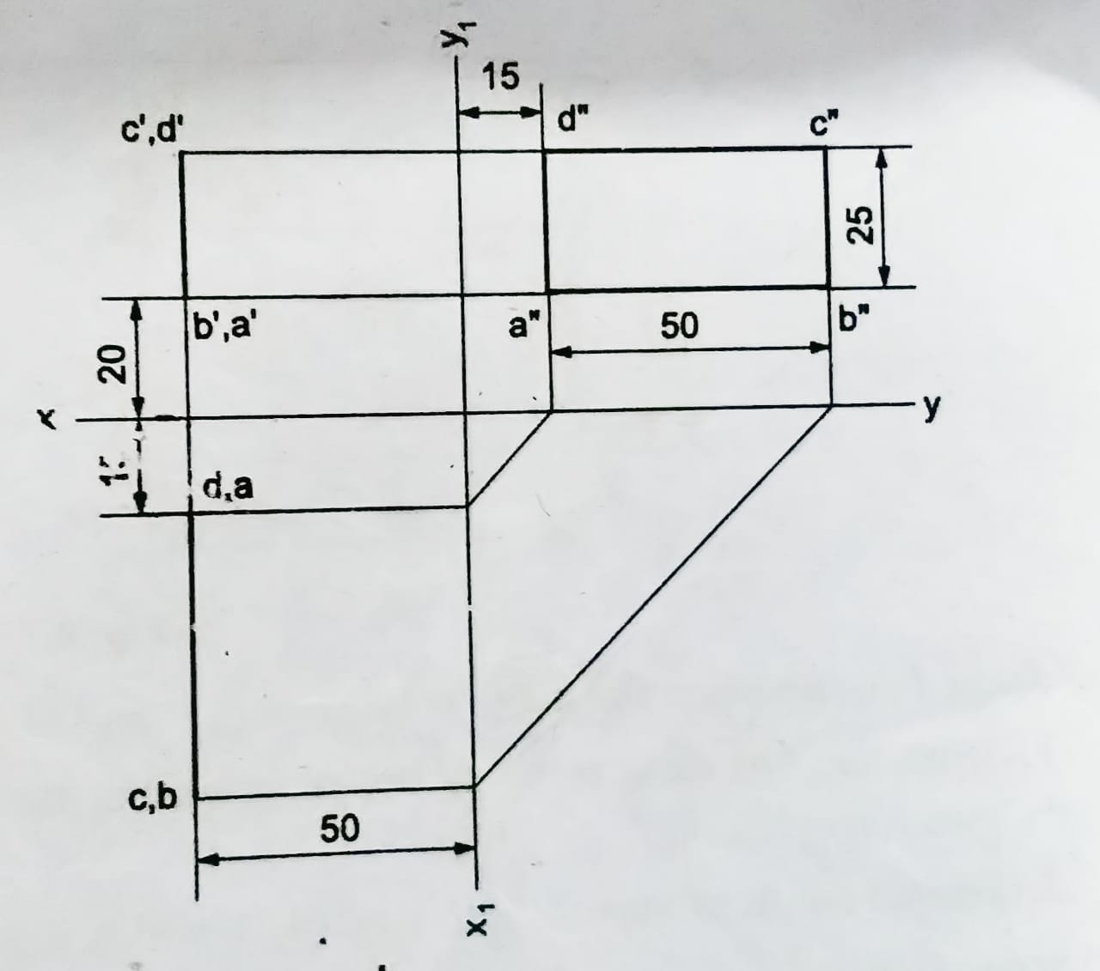
35. A rectangular plane of 50 x 25 size is perpendicular to both H.P and V.P. The longer edges are parallel to H.P and the nearest one is 20 above it. The shorter edge, nearer to V.P is 15 from it. The plane is 50 from the profile plane. Draw the projections of the plane.

Slide 7
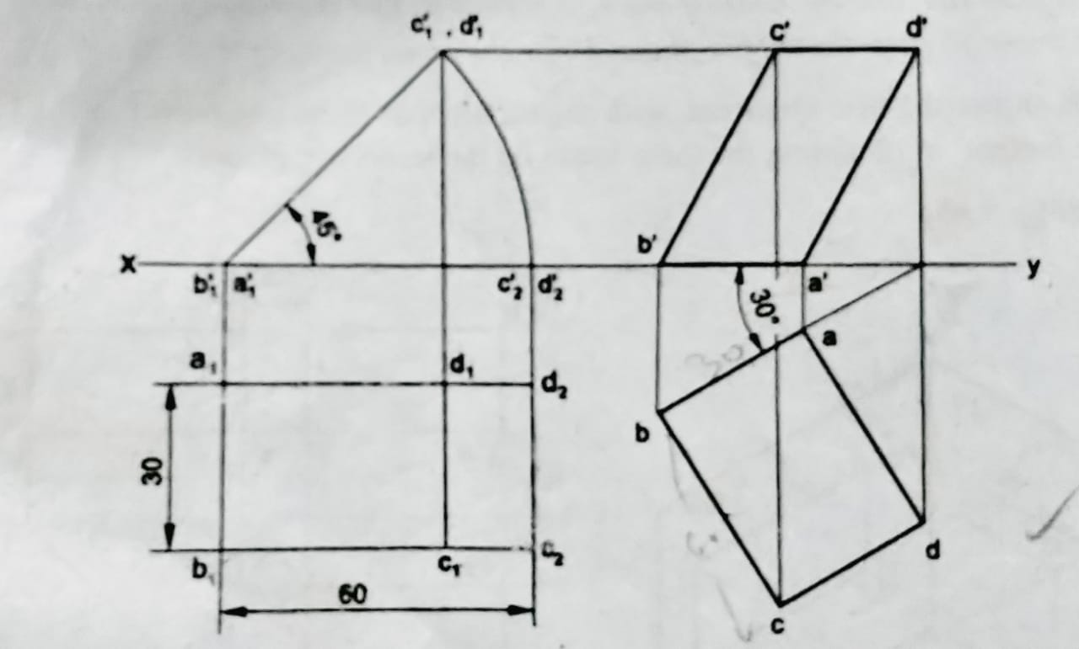
36. A rectangular plane of size 60 x 30 has its shorter side on H.P and inclined at 30° to V.P. Draw the projections of the plane, if its surface is inclined at 45° to H.P.

Slide 8
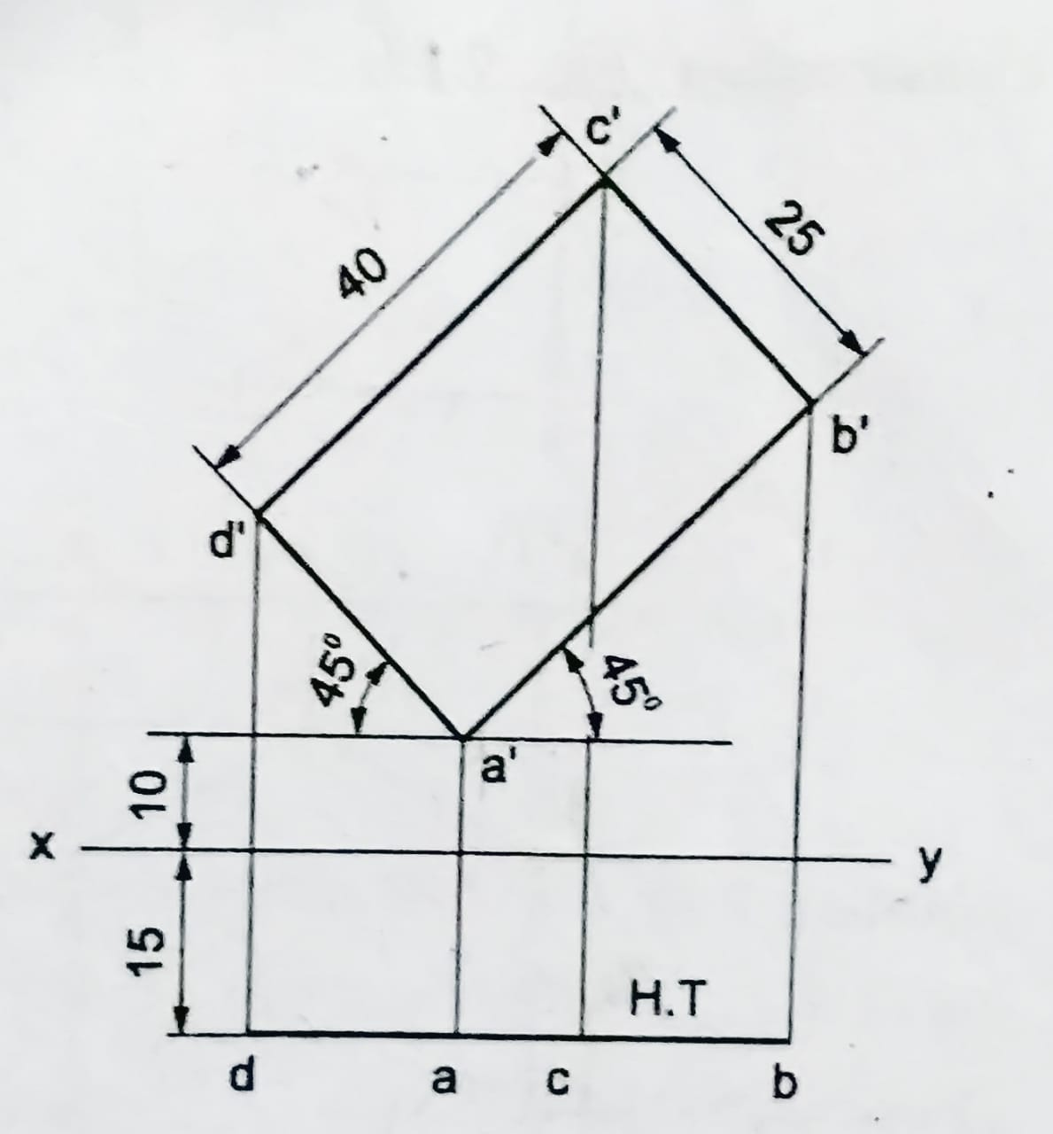
37. A rectangle ABCD of size 40 x 25, has the corner A, 10 above H.P and 15 in front of V.P. All the sides of the rectangle are equally inclined to H.P and parallel to V.P. Draw its projections and locate its traces.

Slide 9
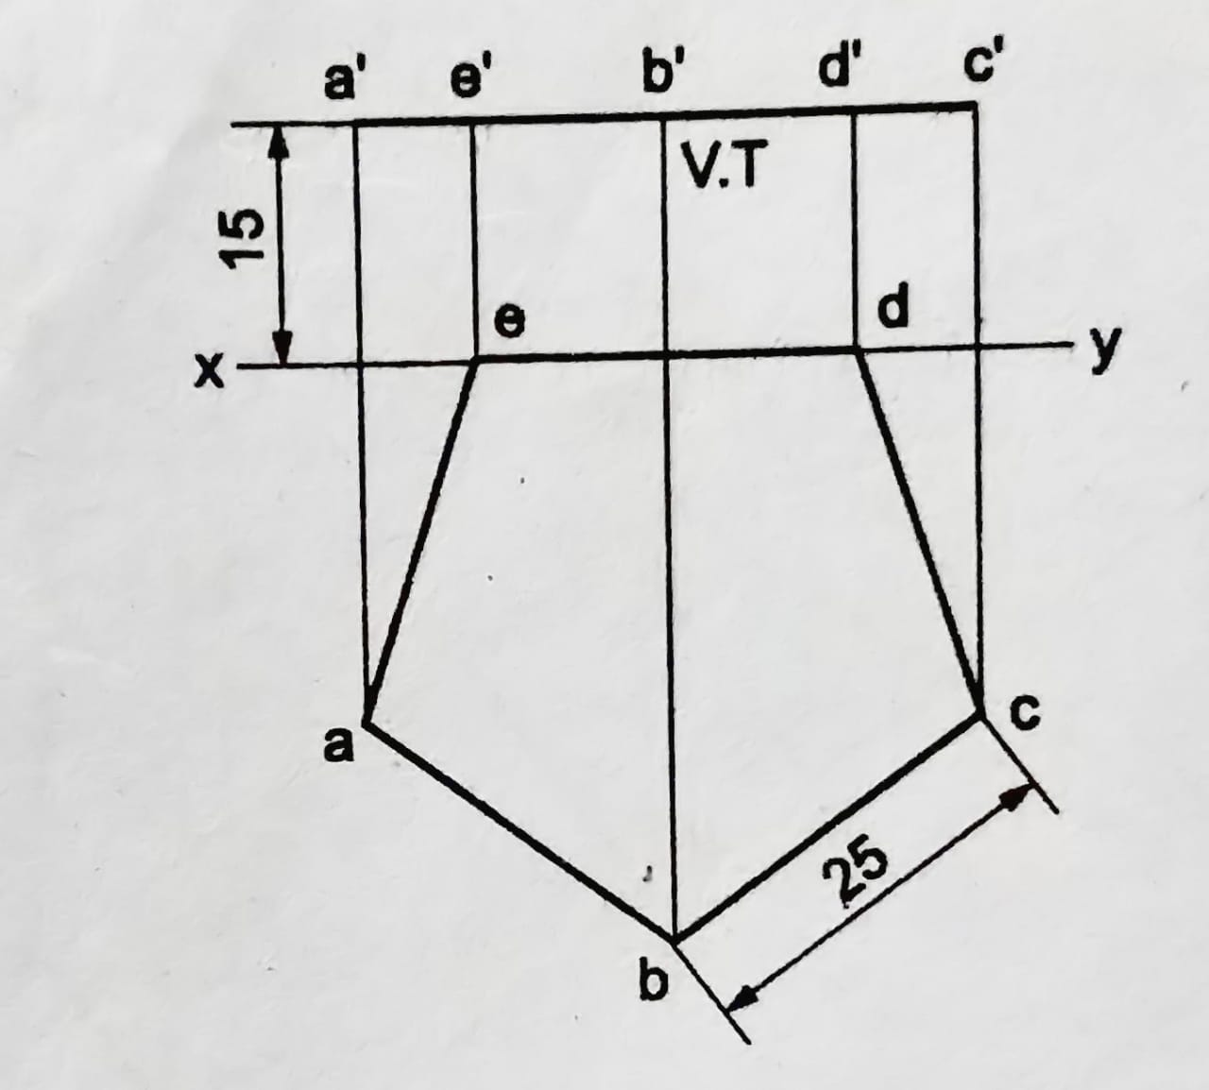
38. A regular pentagon of 25 side is parallel to H.P and perpendicular to V.P. The plane is 15 above H.P and an edge of it lies on V.P. Draw the projections and show its traces.

Slide 10
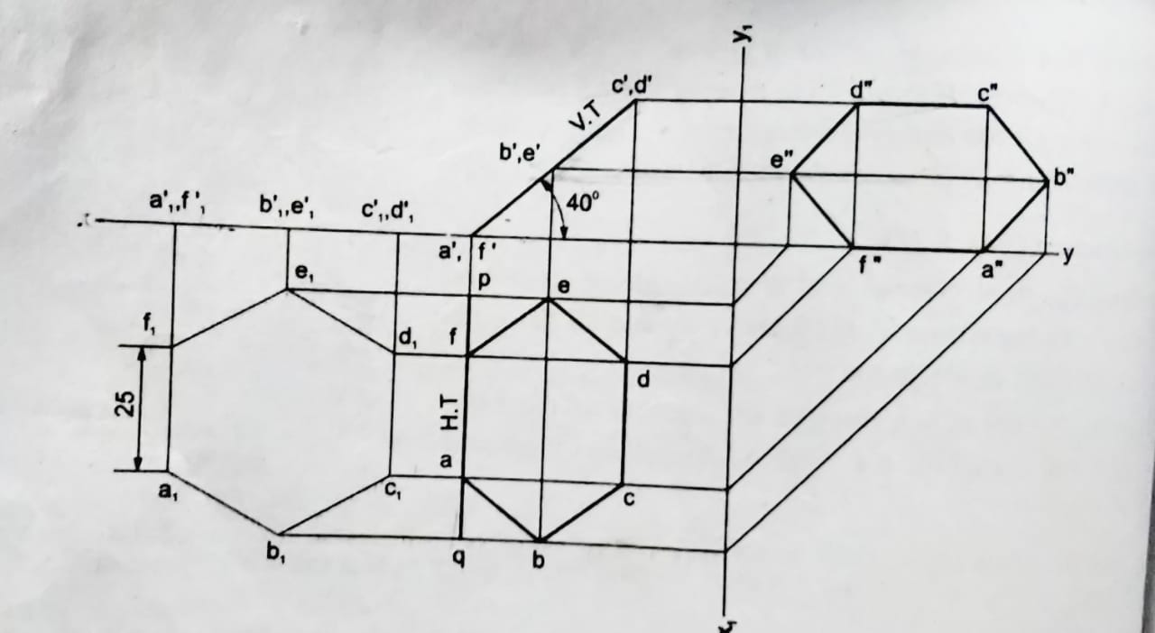
39. A regular hexagon of 25 side has its one edge on H.P. The surface of the plane is perpendicular to V.P and inclined at 40° to H.P. Draw the three views of the plane and locate the traces.

Slide 11
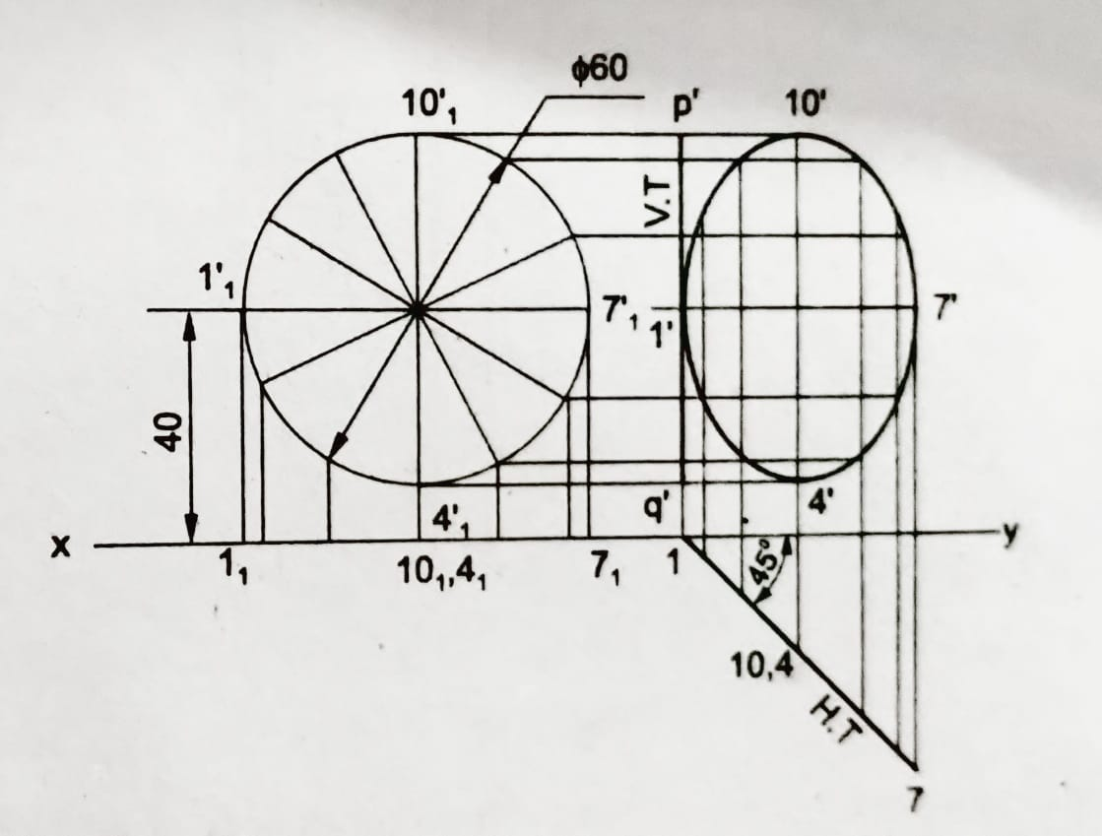
40. Draw the projections of a circle of 60 diameter, resting on V.P on a point on the circumference. The plane is inclined at 45° to VP and perpendicular to H.P. The centre of the plane is 40 above H.P. Also locate its traces.

Slide 12
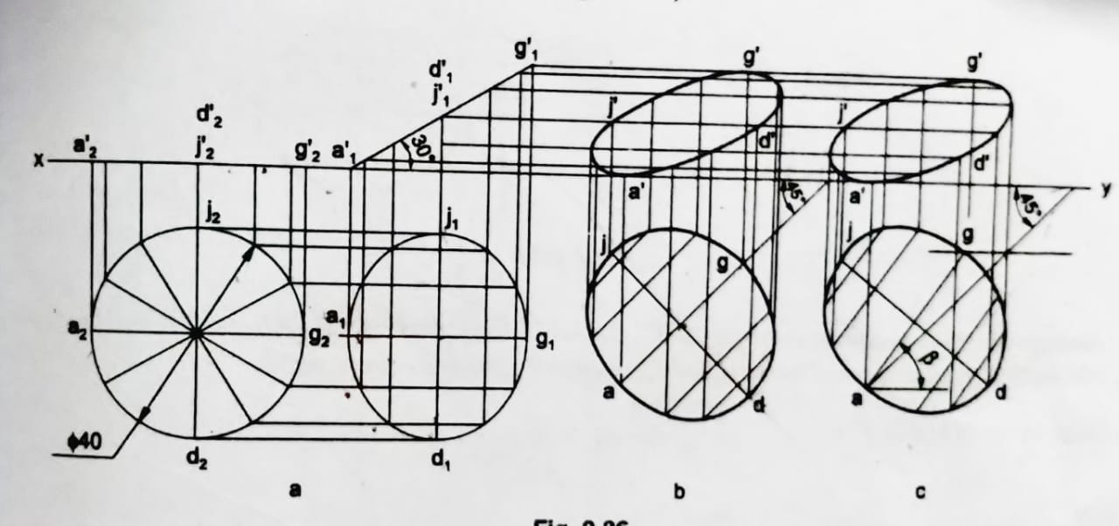
41. A circle of 40 diameter, is resting on H.P on a point, with its surface inclined at 30° to H.P. Draw the projections of the circle, when (i) the top view of the diameter, through the resting point, makes an angle of 45° with xy and (ii) the diameter passing through the resting point makes an angle of 45° with V.P.

Slide 13
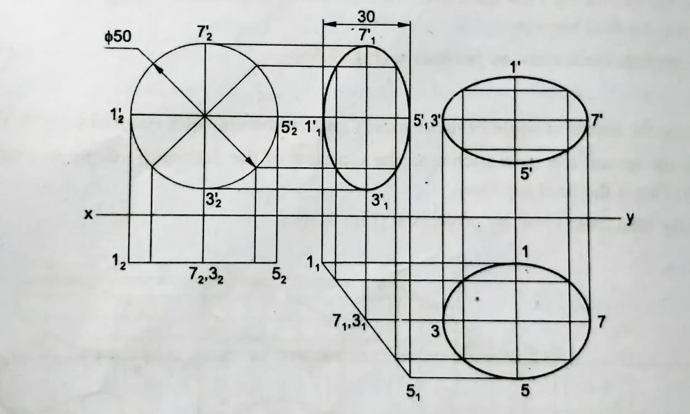
42. A circular plate of 50 diameter, appears as an ellipse in the front view, having its major axis 50 long and minor axis 30 long. Draw the top view, when the major axis of the ellipse is horizontal.

